Slide 1
Module review – part 1 Dr Mariana Rocha School of Computer Science
CMPU 2007 Databases 1, Lecture 12

Slide 2
Databases
A database is a shared persistent collection of logically related data, supporting several different applications within an organisation.
Shared: used simultaneously by many applications and users
Persistent: permanently stored
The data stored is all related in some way

Slide 3
Relational Database
A relational database is a collection of relations or two-dimensional tables.
Some advantages:
Flexible
Promote data integrity
Tables are related via a common data item, allowing access considering user needs
Easy to use – Simple to add to, delete and modify

Slide 4
Issues to bear in mind
Keep the integrity of the database:
Entity integrity: primary keys
Referential integrity: foreign keys
Domain integrity: datatypes and value constraints
Avoid Redundancy:
The same piece of data should not be stored in more than one location unless it is there to achieve referential integrity

Slide 5
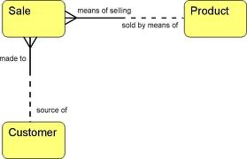
Entity Relationship Model
A representation of the data for an organisation, business area or process

Slide 6
The Entity-Relationship model
Expressed in terms of:
Entities involved (things about which data is to be stored)
Relationships (or associations) among those entities and
Attributes (properties) of both the entities and their relationships

Slide 7
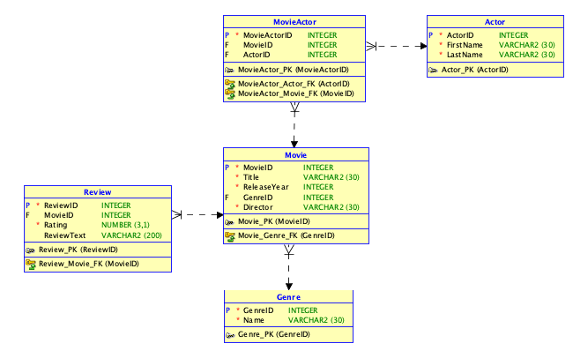
Winter exam – 2023/2024

Slide 8
Winter exam – 2023/2024
Considering the Entity Relationship diagram (ERD) for the case study, clearly explain the following concepts, offering an example of each:
Entity
Attribute
Relationship
Primary Key
Foreign Key

Slide 9
Entity: an entity can be a single thing, person, place, or object. The data about these entities are stored in the database. An example of an entity is the table Actor.
Attribute: an attribute is a property that describes an entity. An example of an attribute is the ReleaseYear.
Relationship: A relationship is the connection between two tables when one table uses a foreign key that references a primary key of another table. An example is the relationship between the tables Review and Movie through the attribute MovieID.
Primary Key: A primary key is an attribute or set of attributes in a table whose values uniquely identify a row in the table. It must be unique, not null and it cannot change. An example of a primary key would be the GenreID attribute in the table Genre.
Foreign Key: A foreign key is an attribute or a set of attributes in a table whose values correspond to the values of the primary key in another table. An example of a foreign key is the ActorID attribute in the table MovieActor.

Slide 10
Relationships
A relationship is an association between two entities which is meaningful for the organisation
A relationship is a natural business association that exists between one or more entities
Relationships usually arise because of
association - a Customer ‘places’ an Order
structure - an Order ‘consists’ of Order-Lines
All relationships that are usable only involve two entities

Slide 11
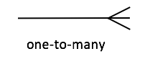
One:Many
One department has multiple instructors. But instructor belongs to only one department.
Hence the cardinality between department and instructor is One to Many (1:N)
Dept_id (PK) | Dept_name
0101 | Computer Science
0202 | Biology
0303 | Physics
0404 | Social Science
Teacher_id (PK) | Dept_id (FK) | Teacher_name
1010 | 0101 | Mariana Rocha
2020 | 0101 | Andrew Smith
3030 | 0101 | Jennifer Vasquez
4040 | 0303 | Paul O’Byrne

Slide 12
Many:Many
Often with many to many relationships there is data associated with the relationship that cannot be
attached sensibly to either entity.
Attaching data to one or other entity results in repeating data (redundancy)

Slide 13
Resolving Many:Many
Introduce a Weak Entity
The primary key of a weak entity is always the combination of the primary keys of the entities in the relationship it is resolving
Why is it weak?
It cannot exist independently of its parent tables
Logically/Conceptually it has no purpose
It only exists to facilitate the physical relational model

Slide 14
Identifying vs Non-Identifying Relationship
Identifying: if the foreign key is part of the primary key it is identifying, and the relationship between the two entities is an identifying relationship
Non-identifying: if the foreign key is not part of the primary key it is non-identifying and the relationship between the two entities is a non-identifying relationship

Slide 15
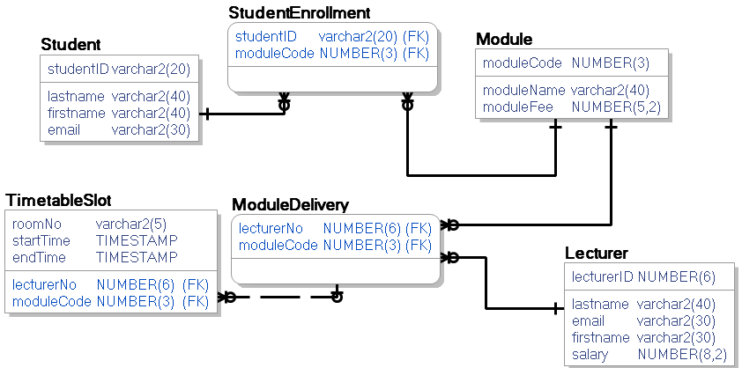
Winter exam – 2017/2018

Slide 16
Winter exam – 2017/2018
For each of the following concepts provide a clear explanation of the concept and identify an example of it from the diagram above:
Entity
Attribute
Primary Key
Foreign Key
Identifying Relationship

Slide 17
Winter exam – 2017/2018 - answer

Slide 18
Winter exam – 2023/2024 - answer
Using the given ERD for the Movies database as a reference, propose and describe a new entity, its attributes, and its relationships with existing entities. Make it relevant to a movie database scenario.

Slide 19
Winter exam – 2023/2024 - answer
Entity Name: Awards
Attributes:
AwardID (Primary Key)
MovieID (Foreign Key)
ActorID (Foreign Key)
AwardName
Category
Year
Relationships:
Each movie can have multiple awards (One-to-Many with Movie).
Each actor can have multiple awards (One-to-Many with Actor).
Description:
The "Awards" entity tracks awards received by movies and actors. It includes details like award name, category, and year. This entity enriches the movie database by showcasing recognition and achievements.

Slide 20
What if you were asked to provide the code?

Slide 21
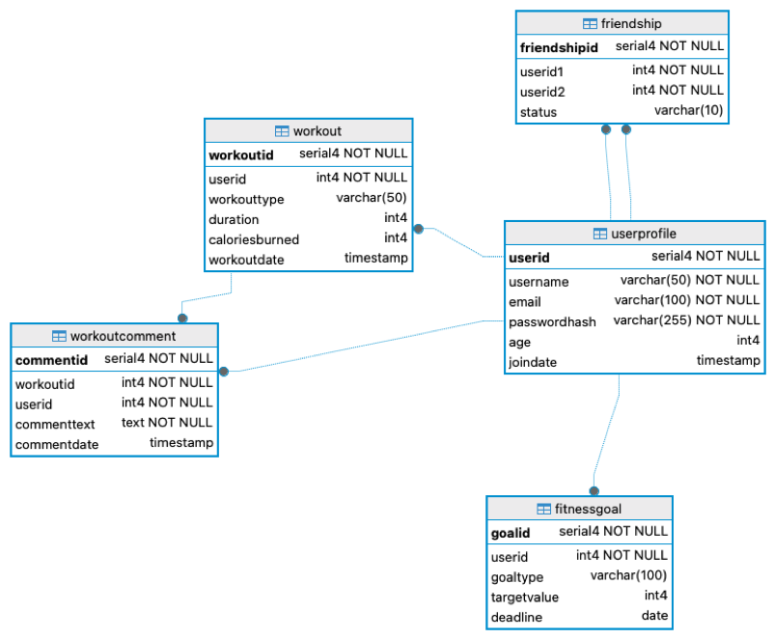
Semester 2 exam – 2024/2025 – TU857
Propose a new entity for the FitLife database and provide the SQL code to create the entity with its attributes, data types, and other constraints.
Sample solution:
CREATE TABLE Achievement (
AchievementID SERIAL PRIMARY KEY,
UserID INT NOT NULL,
AchievementName VARCHAR(100) NOT NULL,
DateEarned DATE,
FOREIGN KEY (UserID) REFERENCES UserProfile(UserID)
);

Slide 22
Normalisation
A formal process involves reflecting on tables, attributes, and relationships to be created when developing a database most efficiently.
The objective of normalisation is to create relations where every dependency is on the key, the whole key, and nothing but the key.
Normalisation reduces data redundancy and increases data integrity, making it easier to save space on the server and maintain and access the data

Slide 23
Semester 2 exam – 2024/2025 – TU857
(a) Considering the process of database normalisation:
• What are the primary objectives of normalisation?
• Describe the three main normal forms
Sample solution:
Database normalisation is a process that structures relational databases to minimise redundancy and enhance data integrity. The first three normal forms (1NF, 2NF, and 3NF) are fundamental in this process:
o First Normal Form (1NF): Requires that data is stored in tables with rows and columns, ensuring each column contains atomic values (indivisible). It eliminates repeating groups and allows for unique primary keys.
o Second Normal Form (2NF): Building on 1NF eliminates partial dependencies by ensuring that non-key attributes depend on the entire primary key. This is achieved by breaking data into separate related tables.
o Third Normal Form (3NF): Further refines the structure by removing transitive dependencies, ensuring that non-key attributes are not dependent on other non-key attributes. This typically results in smaller, more manageable tables.

Slide 24
ALTER TABLE Statement
Use the ALTER TABLE statement to:
Add a new column
Modify an existing column
Define a default value for the new column
Drop a column
Add a constraint
Drop a constraint

Slide 25
Adding column(s) to a table
To add a column to an existing table:
ALTER TABLE table_name
ADD COLUMN column_name datatype column_constraint;
To add multiple columns to an existing table:
ALTER TABLE table_name
ADD COLUMN column_name1 data_type constraint,
ADD COLUMN column_name2 data_type constraint,
...
ADD COLUMN column_namen data_type constraint;

Slide 26
Drop column(s)/Rename column(s) in a table
To remove a column in an existing table:
ALTER TABLE table_name
DROP COLUMN column_name;
To rename a column in an existing table:
ALTER TABLE table_name
RENAME COLUMN column_name
TO new_column_name;

Slide 27
Altering to add constraints
ALTER TABLE table_name
ADD CHECK expression;
ALTER TABLE links
ADD CONSTRAINT unique_url UNIQUE ( url );

Slide 28
Winter exam – 2022/2023
Suppose the game, platform and genre tables have been created in an Oracle database with the attributes and datatypes identified in the model given in question 1, part (a). Write the SQL needed to add the following value constraints to the tables using the ALTER statements:
• The first character of the game_id must be one of the following: P, L, D, A;
• Publishers’ email addresses must include both the @ symbol and the . symbol;
• The last digit of a platform_id must be between 1 and 6;
• The first character of genre_id must be between A and Z;
• The genre_name must be one of the following values: adventure, RPG, simulation, puzzle.

Slide 29
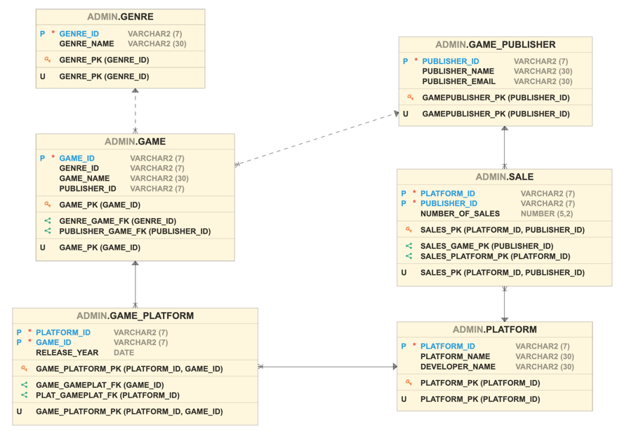
Winter exam – 2022/2023

Slide 30
Winter exam – 2022/2023
Sample solution:
ALTER TABLE GAME ADD CONSTRAINT CHK_GAMEID CHECK (SUBSTR(GAMEID,1,1) IN ('P','L','D','A'));
ALTER TABLE PUBLISHER ADD CONSTRAINT CHK_PUBL_EMAIL CHECK (EMAIL LIKE '%@%' AND EMAIL LIKE '%.%');
ALTER TABLE PLATFORM ADD CONSTRAINT CHK_PLATID CHECK (SUBSTR(platform_id, -1, 1) BETWEEN 1 AND 6));
ALTER TABLE GENRE_ID ADD CONSTRAINT CHK_GENREID CHECK (SUBSTR(GENRE_ID,1,1) BETWEEN 'A' AND 'Z');
ALTER TABLE GENRE ADD CONSTRAINT CHK_GENRENAME CHECK (GENRE_NAME IN ('ADVENTURE','RPG','SIMULATION','PUZZLE'));

Slide 31
Identifying errors in the queries

Slide 32
Winter exam – 2022/2023
The following SQL queries were written as an attempt to insert data into the video game database. However, each query returned an error. Identify and explain the errors in the queries below:
INSERT INTO game_publisher VALUES ('Pewter Games', 'pewter@email.com');
INSERT INTO game VALUES ('1453', 5555, Super Mario, 1234);
INSERT INTO platform (platform_id, platform_name, developer_name) VALUES (4321, 'Xbox’, ‘Brain Games Studio', 'Mabel Addis');

Slide 33
Winter exam – 2022/2023

Slide 34
Winter exam – 2022/2023 - answer
The first SQL statement attempts to do a partial insertion without listing the attributes, which results in a “not enough values” error.
The second SQL statement attempts to insert a string value without single quotes, which results in an error.
The third SQL statement attempts to insert more values than attributes available, resulting in the error “too many values”.

Slide 35
SQL functions
SQL functions are built-in operations that take one or more values and return a result.
They are widely used for data transformation, formatting, calculations, and aggregation.

Slide 36
Single-row functions
Process one row at a time
Return one result per row
Can be used in SELECT, WHERE, ORDER BY
Do not change the number of rows returned
Examples:
String functions: UPPER(name), LOWER(email), LENGTH(title)
Number functions: ROUND(salary,2), ABS(value)
Date functions: TO_CHAR(date, 'DD/MM/YYYY’)
Conversion functions: TO_NUMBER, TO_CHAR, CAST

Slide 37
Multiple-row functions (also called aggregate or group functions)
Operate on multiple rows at once
Return one result per group
Used with GROUP BY
Ignore NULL values (except COUNT(*))
Examples:
COUNT(*): counts rows
COUNT(column): counts non-NULL values
SUM(amount)
AVG(score)
MAX(price) / MIN(price)

Slide 38
Winter exam – 2024/2025 – TU857
Write an SQL query to count how many friends each user has.
SELECT UserProfile.Username, COUNT(Friendship.FriendshipID) AS FriendCount
FROM UserProfile
LEFT JOIN Friendship ON UserProfile.UserID = Friendship.UserID1
WHERE Friendship.Status = 'Accepted'
GROUP BY UserProfile.Username;

Slide 39
Winter exam – 2024/2025 – TU857
Write an SQL query to retrieve the user’s name and the total calories burned by each user. Rename the resulting columns as “Name” and “Total Calories”
SELECT UserProfile.Username “Name”, SUM(Workout.CaloriesBurned) “Total Calories”
FROM UserProfile
LEFT JOIN Workout USING (UserID)
GROUP BY UserProfile.Username;

